Slide 1
A Theological Response to
World War II
Ted Grimsrud
1. Was this war necessary (did it have just causes)?
2. Were the means used in this war just?
3. What were the costs of this war?
4. What were the long-term consequences of this war?
5. Is there an alternative story?
“World War II was the greatest disaster in human history, but was this a just war that Americans had to fight despite its appalling price? Was it worth the massive disruption of American society on the home front, with its racial tensions, displaced families, marital discord, and juvenile delinquency? Was this a war worthy of the sacrifice of hundreds of thousands of Americans overseas who suffered untold miseries and gave their bodies and their minds and their lives? And in the worldwide perspective, did this war justify the final butcher’s bill of 78 million dead?”
Kenneth D Rose, Myth of the Greatest Generation: A Social History of Americans in World War II, 251.

Slide 2
Franklin Roosevelt’s “Four Freedoms” speech, January 6, 1941:
(1) Freedom of speech and expression,
(2) Freedom to worship God in one’s own way
(3) Freedom from want, and
(4) Freedom from fear
”Everywhere in the world.”

Slide 3
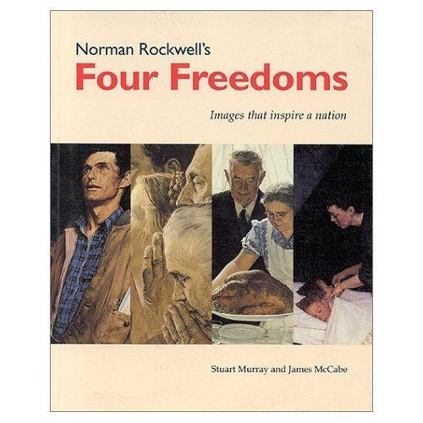

Slide 4
The Atlantic Charter, August 14, 1941
The eight principal points:
1. No territorial gains were to be sought by the United States or the United Kingdom;
2. Territorial adjustments must be in accord with the wishes of the peoples concerned;
3. All peoples had a right to self-determination;
4. Trade barriers were to be lowered;
5. There was to be global economic cooperation and advancement of social welfare;
6. The participants would work for a world free of want and fear;
7. The participants would work for freedom of the seas;
8. There was to be disarmament of aggressor nations, and a postwar common disarmament.

Slide 5
1. Was this war necessary (did it have just causes)?
The jus ad bellum questions
2. Were the means used in this war just?
The jus in bello questions
3. What were the costs of this war?
4. What were the long-term consequences of this war?
5. Is there an alternative story for postwar America?

Slide 6
1. Was this war necessary (did it have just causes)?
The jus ad bellum questions
Were the means used in this war just?
The jus in bello questions
What were the costs of this war?
What were the long-term consequences of this war?
Is there an alternative story for postwar America?

Slide 7
“I find it almost incomprehensible that anyone would claim to discover moral ambiguity in World War II. Machiavelli was quite right when describing a necessary war as a just war. If World War II was not necessary, no war has been.”
Eric Bergerud, “Critique of Choices Under Fire.” Historically Speaking (March/April 2008), 41.

Slide 8
Was World War II necessary for the United States? Why did we fight?
(1) To maintain our national autonomy?
(2) To protect democracy against totalitarianism?
(3) To save the Jews?

Slide 9
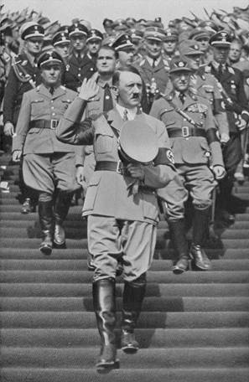

Slide 10
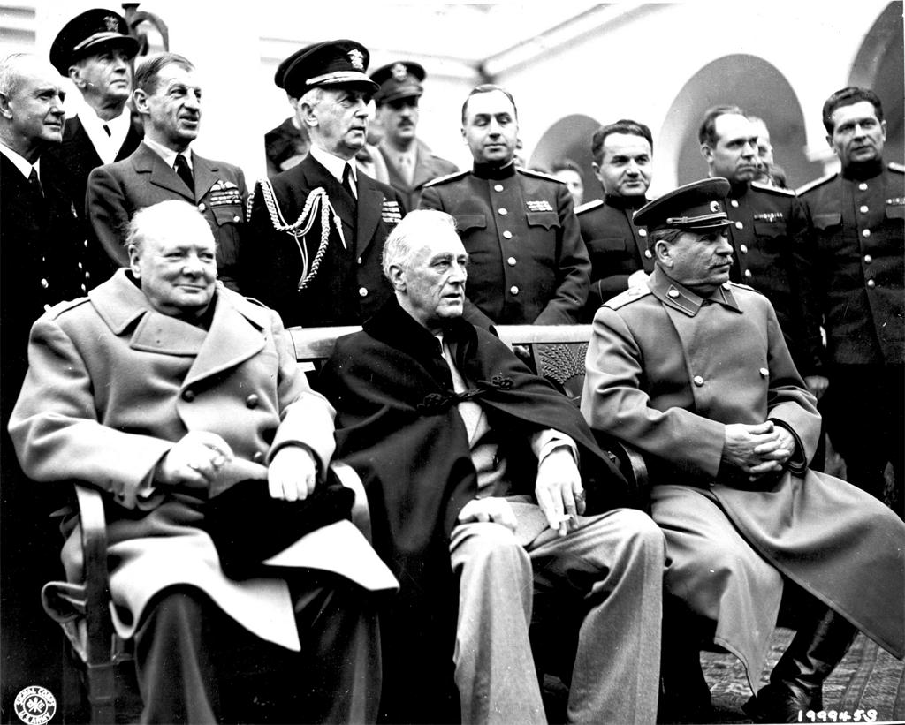
The “Big Three” meet [Churchill (Britain), Roosevelt (U.S.), Stalin (Soviet Union)]—Yalta, March 1945

Slide 11
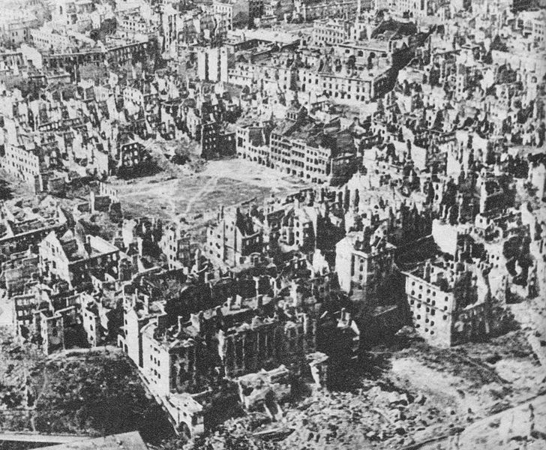
Warsaw, Poland—1945

Slide 12
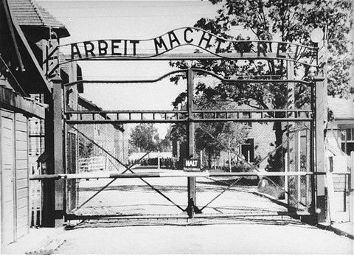
Entrance to the Auschwitz concentration camp

Slide 13
Why did the United States fight World War II?
• A conflict between American and Japanese imperialisms over the Far East
• Strong alliance with Britain’s non-democratic global empire
• Germany’s undermining American corporations’ interests
• The growing awareness of the potential for American world dominance—economically and militarily

Slide 14
Was this war necessary (did it have just causes)?
The jus ad bellom questions
2. Were the means used in this war just?
The jus in bello questions
Proportionality
Noncombatant immunity
What were the costs of this war?
What were the long-term consequences of this war?
Is there an alternative story for postwar America?

Slide 15
“I call upon the European powers to promise not to bomb civilians. I am afraid hundreds of thousands of innocent human beings who have no responsibility for, and who are not even remotely participating in, the hostilities would be killed. Let the belligerents determine that their armed forces shall in no event, and under no circumstances, undertake the bombardment from the air of civilian populations or of unfortified cities.”
President Franklin Roosevelt, radio address, September 1, 1939 (two days before Great Britain declared war on Germany).

Slide 16
Hamburg, July 1943

Slide 17
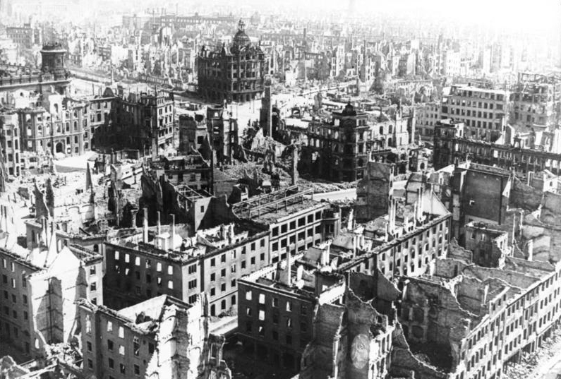
Dresden—February 1945

Slide 18
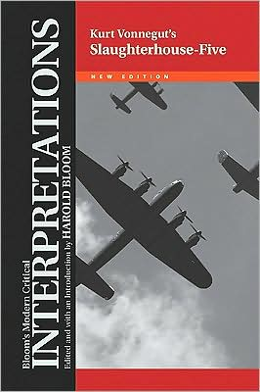

Slide 19
Hamburg, July 1943

Slide 20
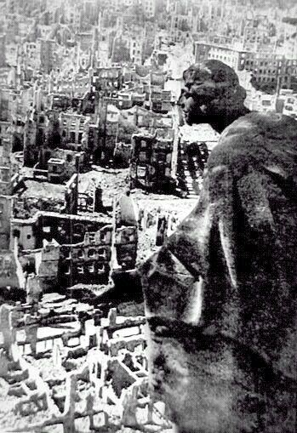
Dresden, February 1945

Slide 21
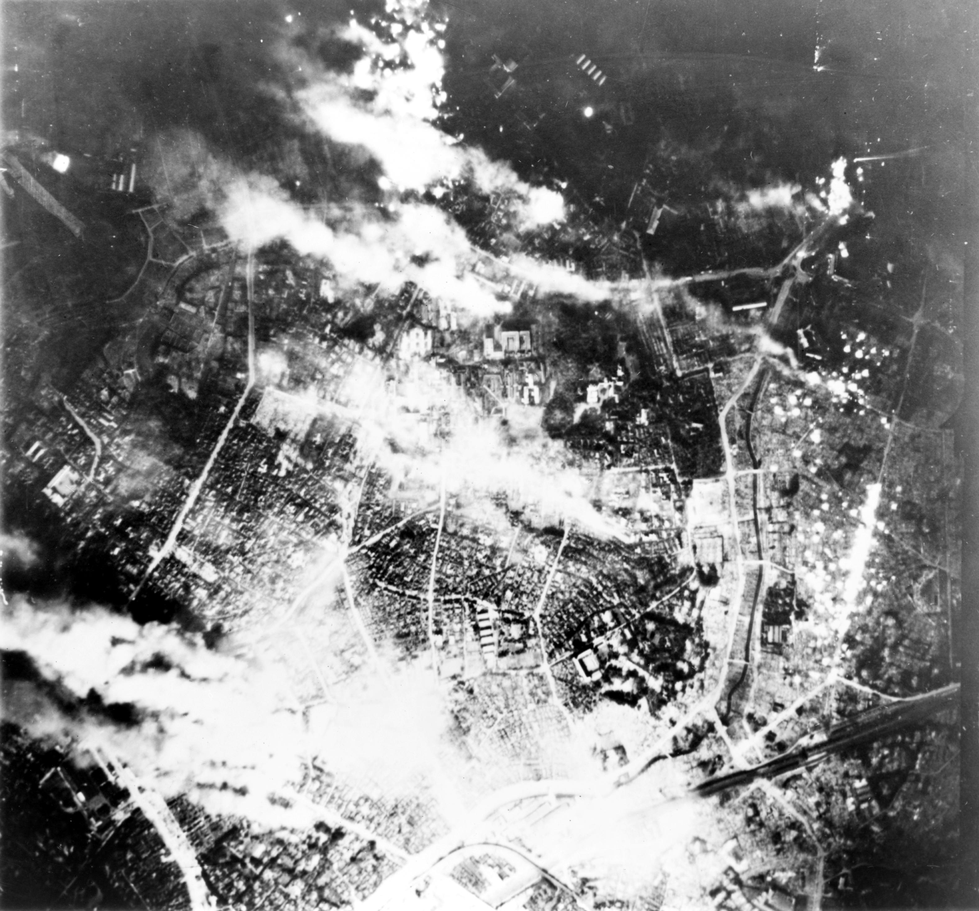
Firebombing of Tokyo, March 1945

Slide 22
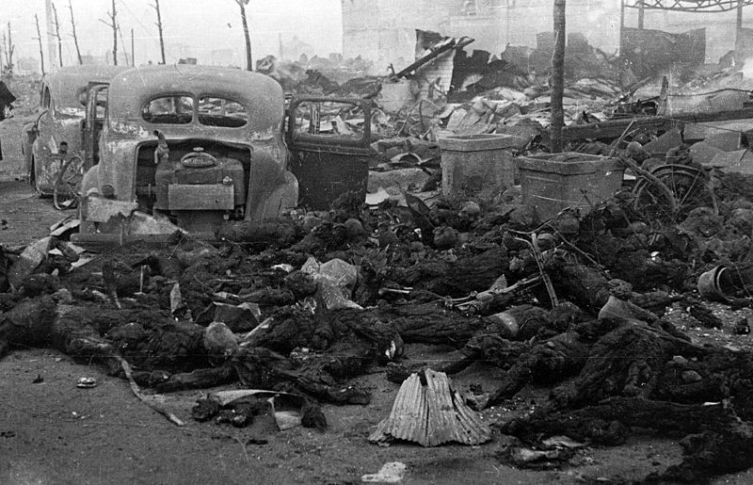
Tokyo, March 1945

Slide 23
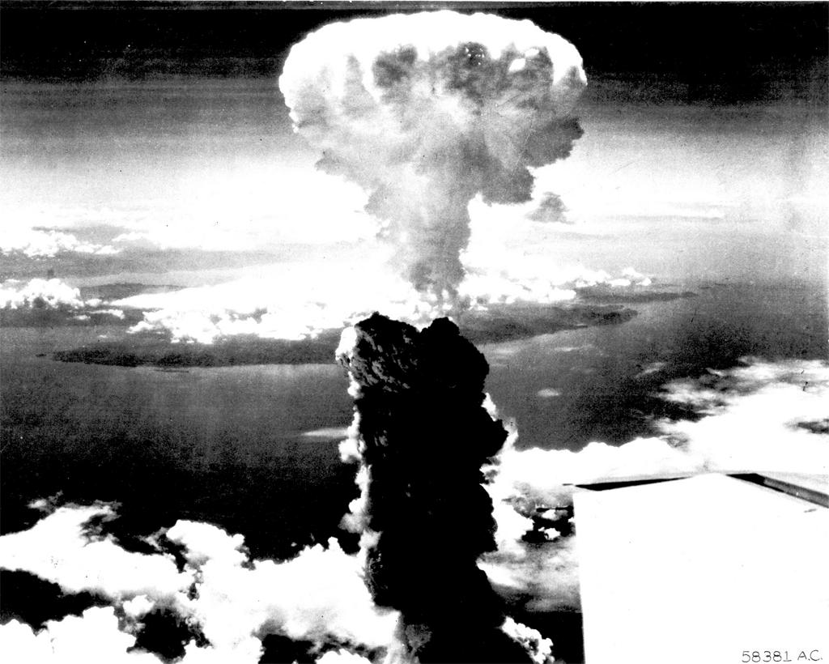
Hiroshima

Slide 24
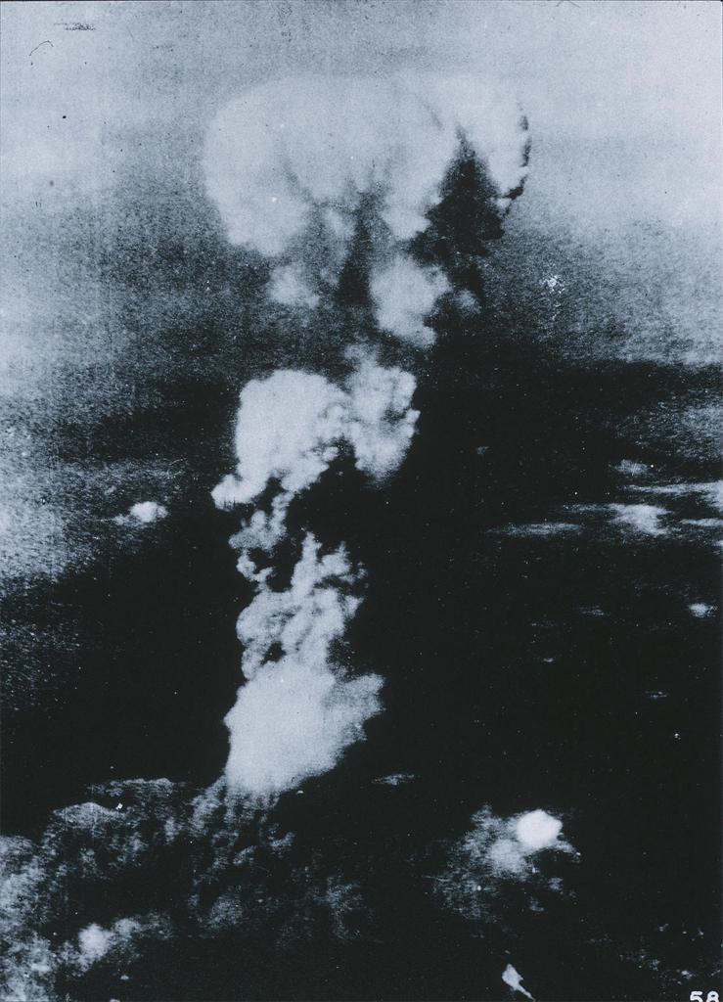
Nagasaki

Slide 25
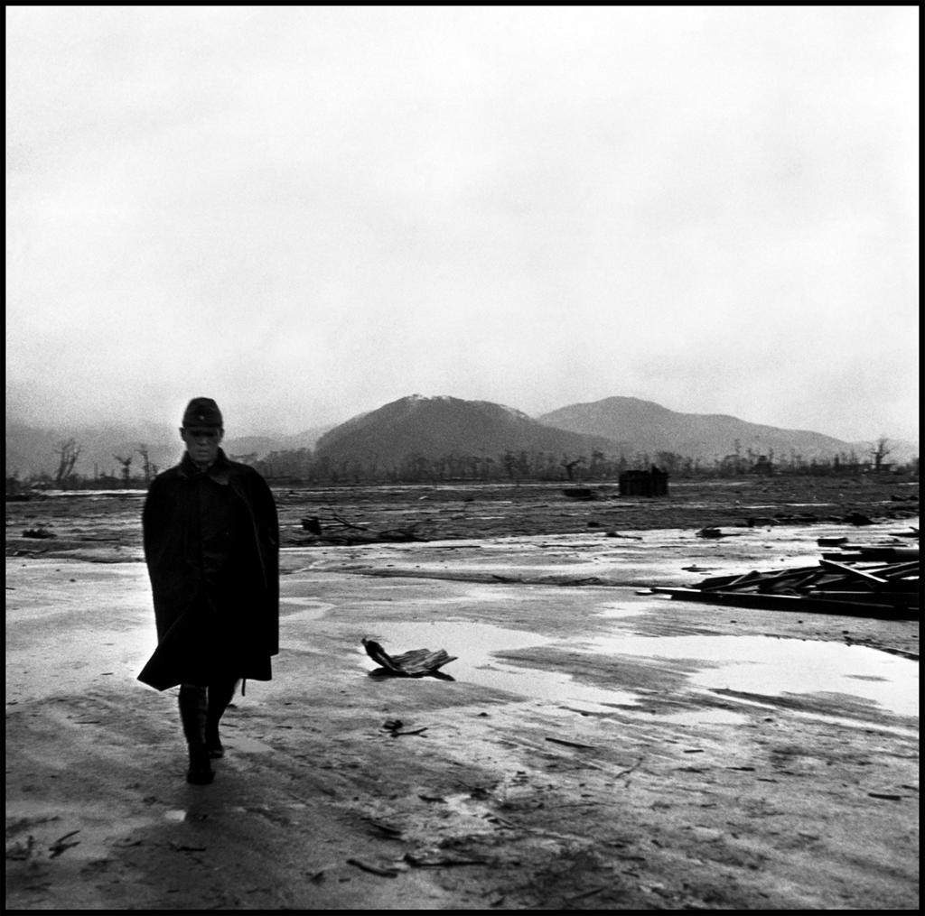
Hiroshima—the former city center

Slide 26
Total tonnage of bombs dropped by U.S. and Britain on Germany and Japan during World War II
3.4 million tons
Total tonnage of bombs dropped by U.S. on Indochina during Vietnam War 6.7 million tons
Total tons dropped on the U.S. during both wars—virtually none

Slide 27
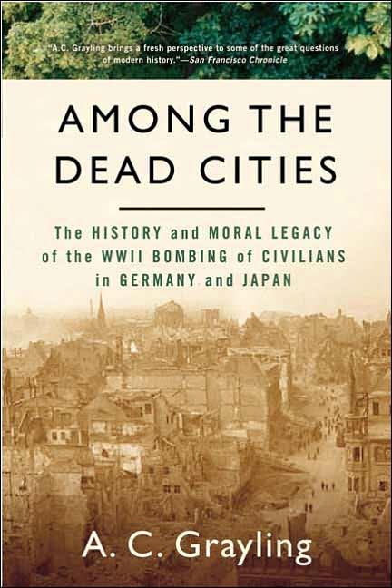

Slide 28
Was this war necessary (did it have just causes)?
Were the means used in this war just?
3. What were the costs of this war?
What were the long-term consequences of this war?
Is there an alternative story for postwar America?

Slide 29
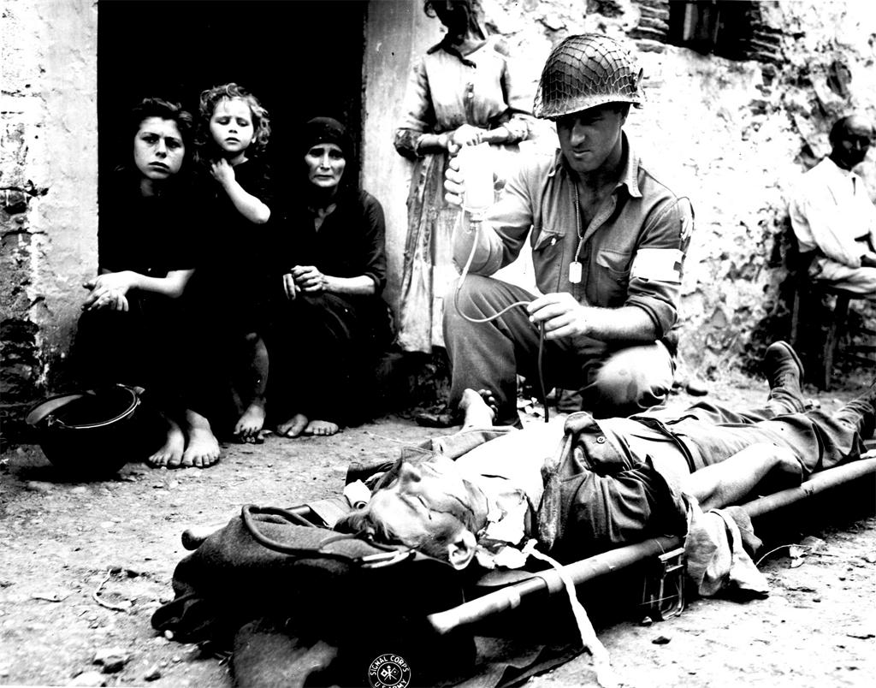
An American casualty

Slide 30
Deaths Due to World War II (approximations)
United States 400,000
Great Britain 450,000
Soviet Union 26,000,000
Germany 9,600,000
Japan 2,700,000
Poland 5,800,000
China 20,000,000
Yugoslavia 1,000,000
Philippines 1,000,000
French Indochina (Vietnam, Cambodia, Laos) 1,500,000
India 2,600,000
Dutch East Indies (Indonesia) 4,000,000

Slide 31
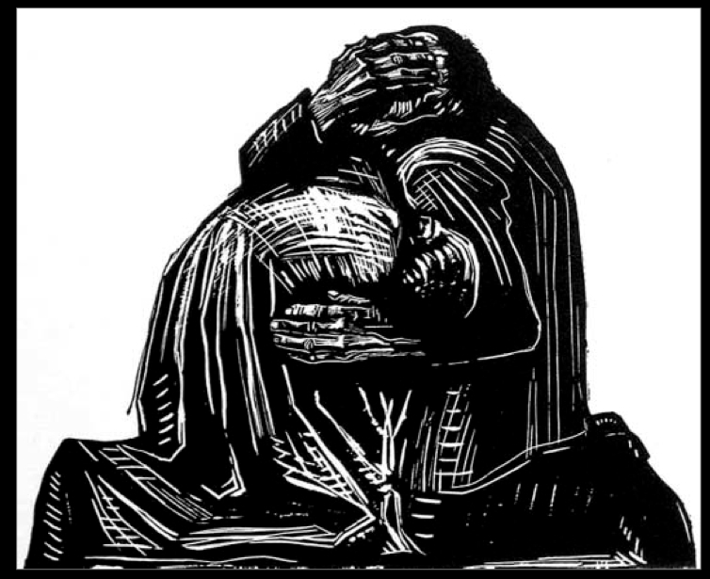
Kathë Kollwitz, “The Grieving Parents”

Slide 32
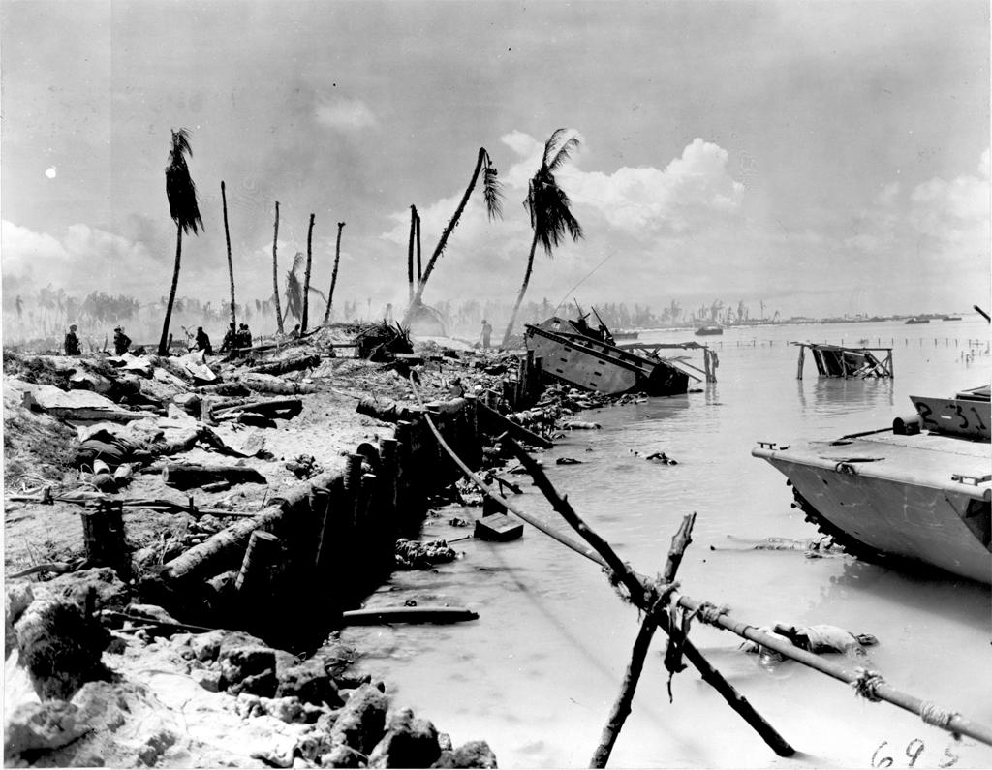
The war in the Pacific

Slide 33
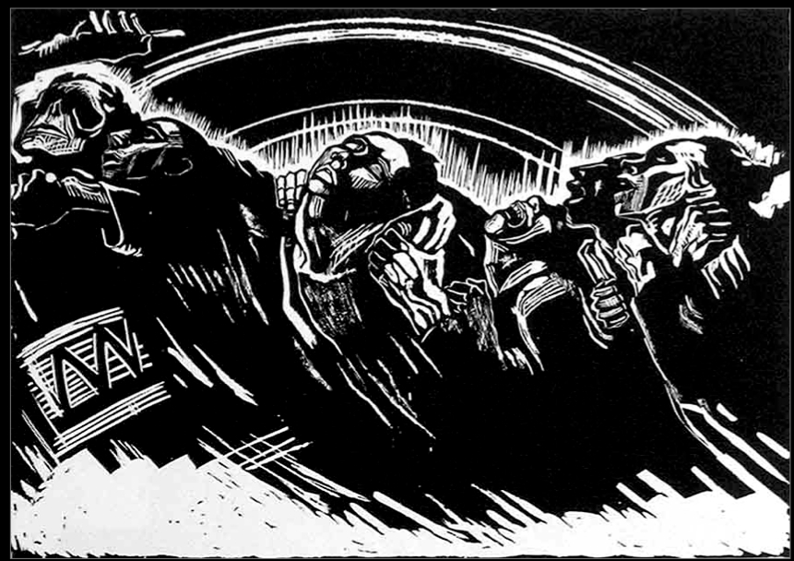
Käthe Kollwitz, “War”

Slide 34
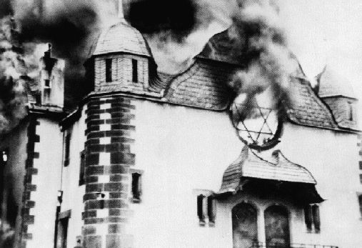
Germany, November 10, 1938

Slide 35
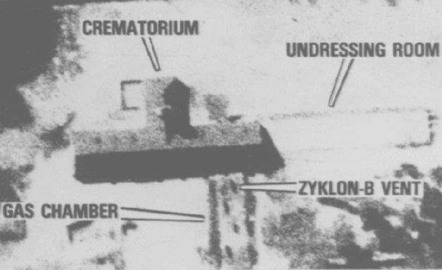
Auschwitz

Slide 36
“War…exponentially increased the numbers and kinds of victims….War provided killers with both a cover and an excuse for murder; in wartime, killing was normalized, and extreme, even genocidal measures could be justified with familiar arguments about the need to defend the homeland. Without the war, the Holocaust would not—and could not—have happened.”
Doris L. Bergen, War and Genocide: A Concise History of the Holocaust, second edition (Lanham, MD: Rowman and Littlefield, 2009), vii.

Slide 37
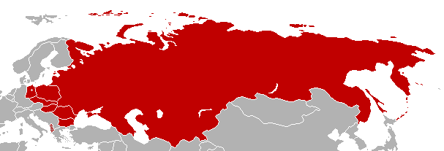
Map of Warsaw Pact nations

Slide 38
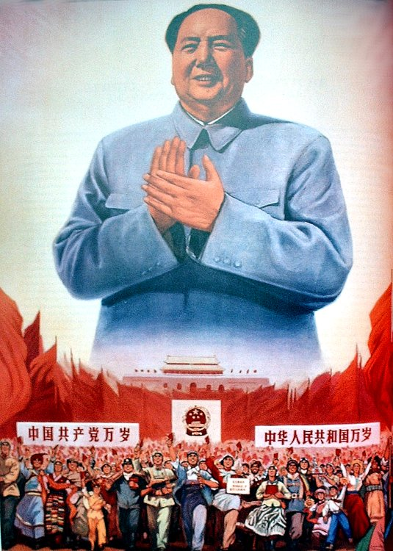
Mao Zedung, China’s “Great Leader”

Slide 39
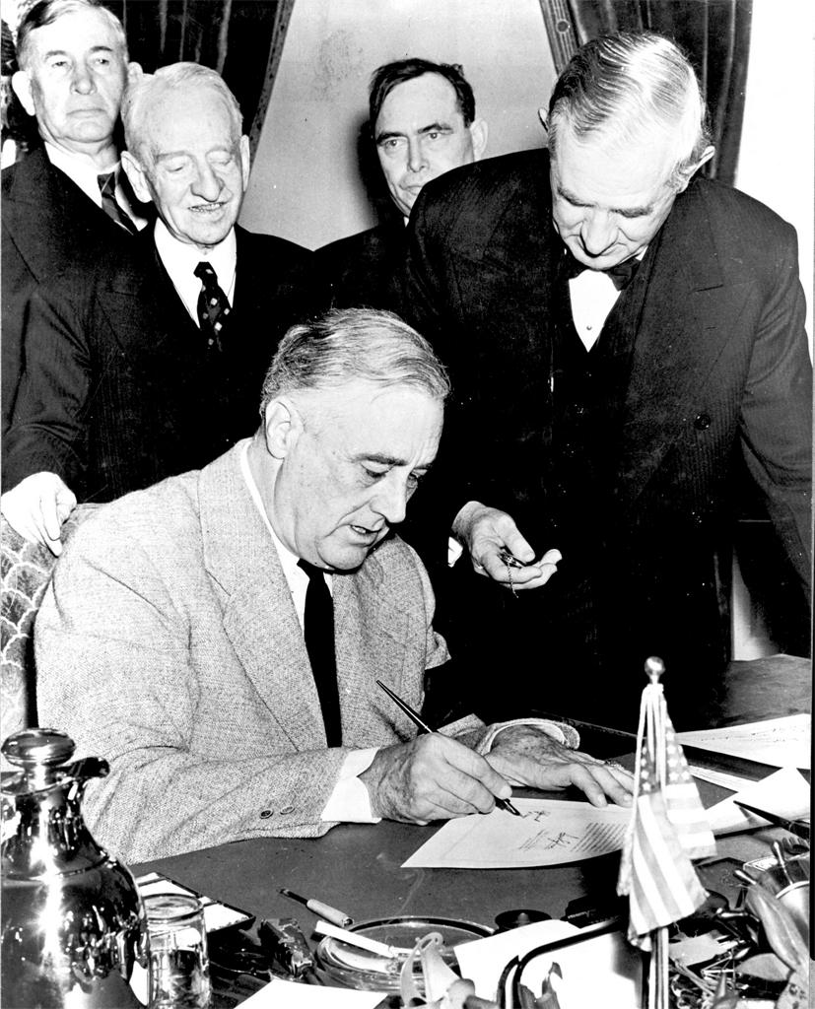
Franklin Roosevelt declares war
December 8, 1941

Slide 40
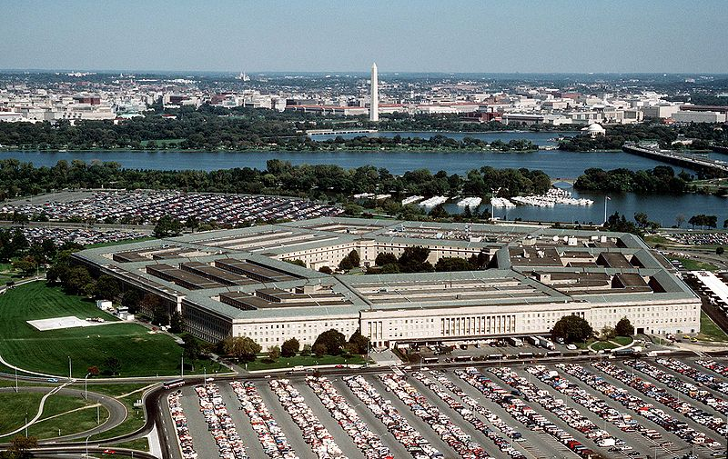
The Pentagon

Slide 41
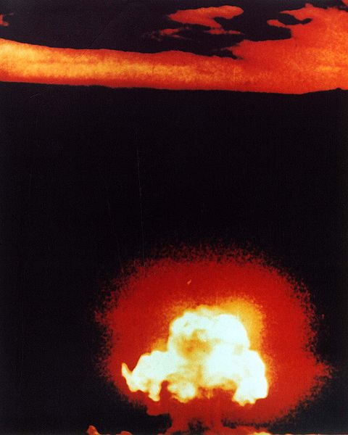
The first nuclear bomb—tested in New Mexico, July 1945

Slide 42
Was this war necessary (did it have just causes)?
Were the means used in this war just?
What were the costs of this war?
4. What were the long-term consequences of this war?
Is there an alternative story for postwar America?

Slide 43
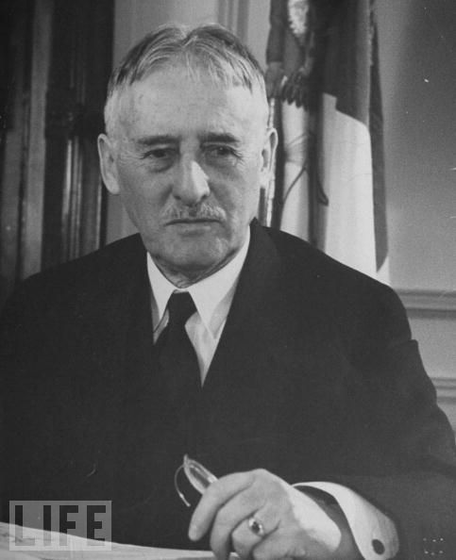
Secretary of War Henry Stimson

Slide 44
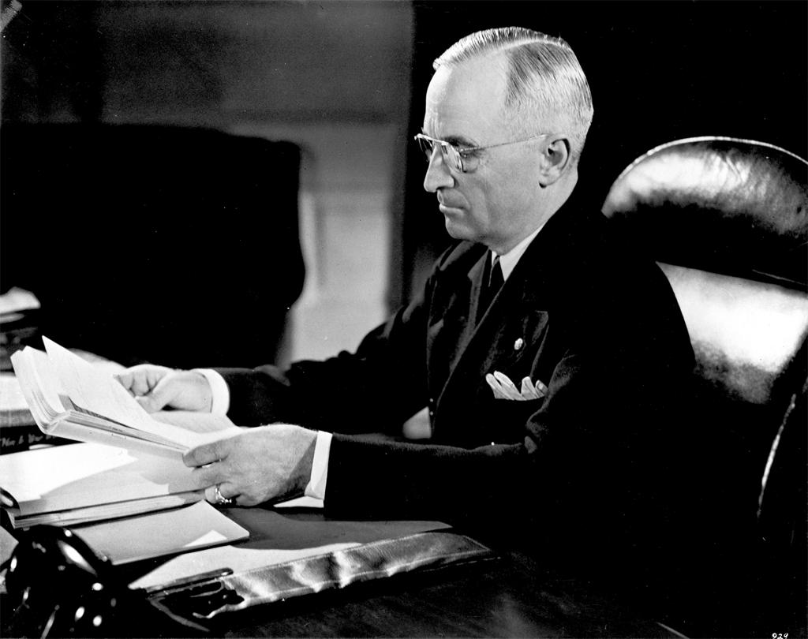
President Harry Truman

Slide 45
Anywhere in the world where Communism arises, it constitutes a direct threat to the security of the United States and must be met with force.
The “Truman Doctrine” (1947)

Slide 46
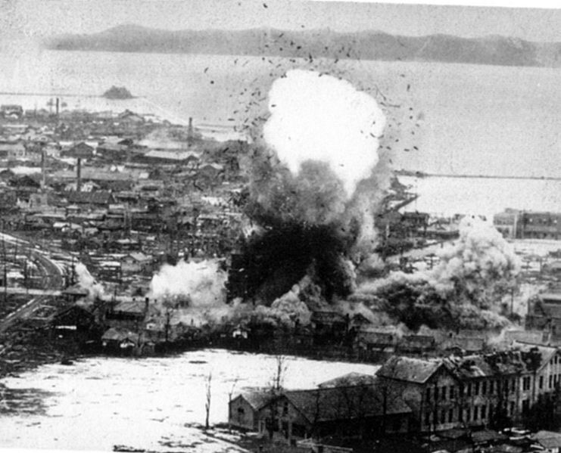
Korean War—Bombing Wonsan

Slide 47
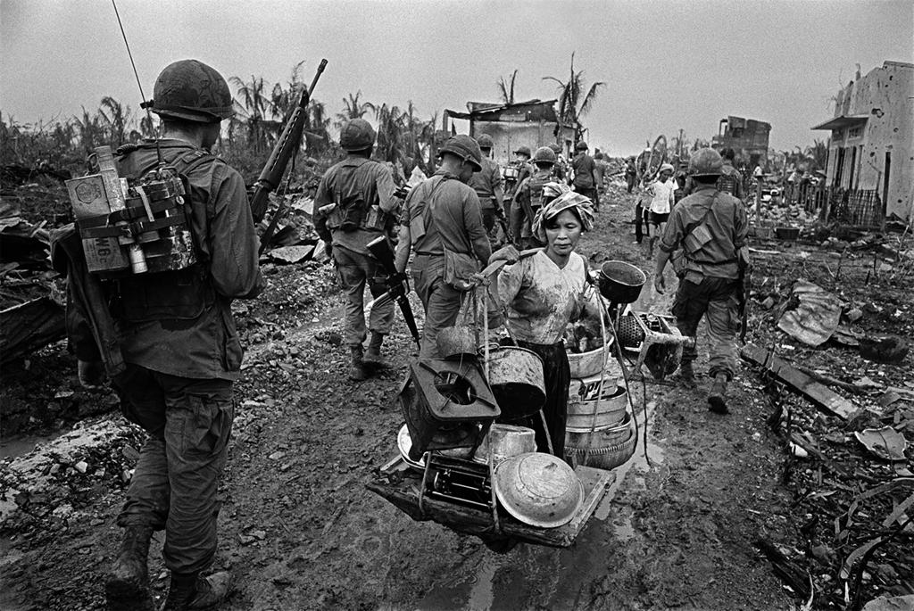
The Vietnam War

Slide 48
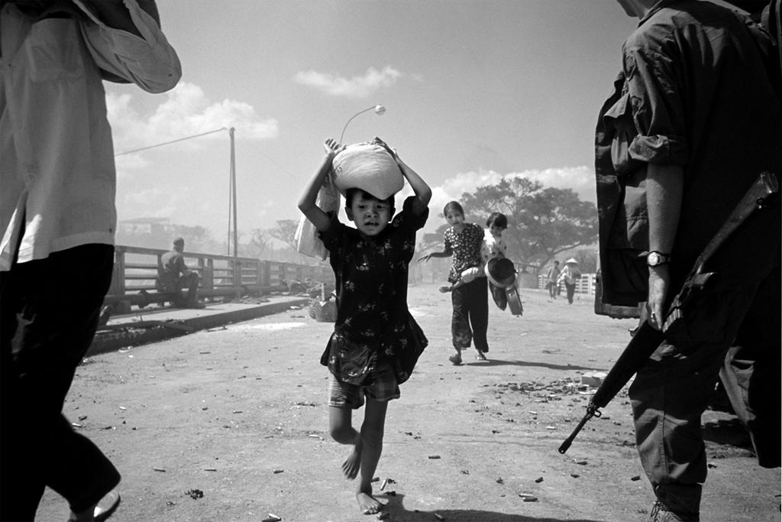
The American War in Vietnam

Slide 49
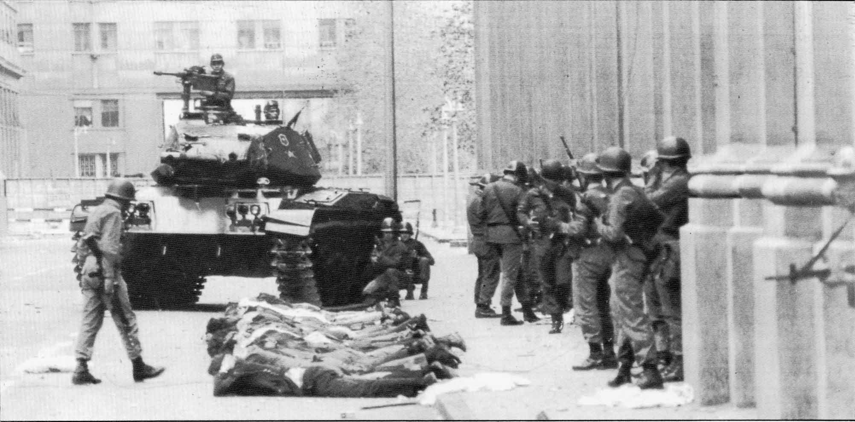
September 11, 1973—Santiago, Chile

Slide 50
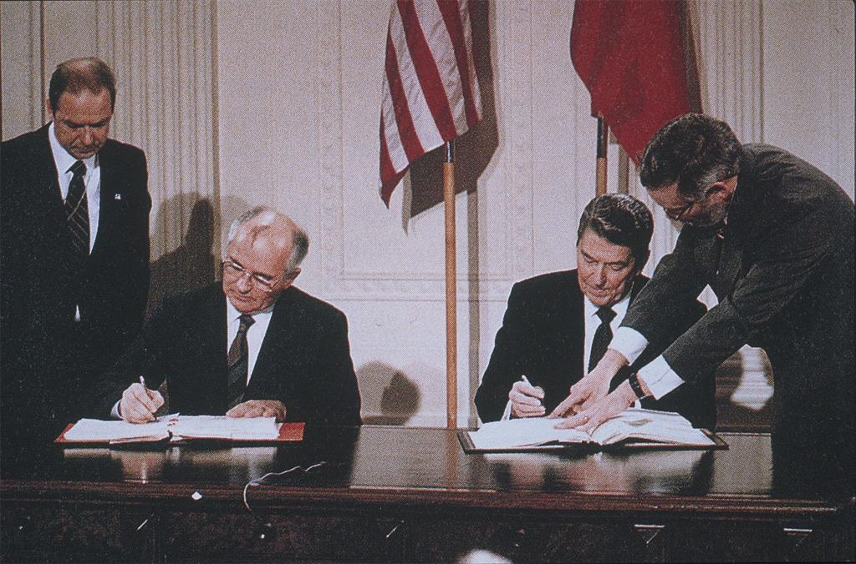
Gorbachev and Reagan, 1988

Slide 51


Slide 52
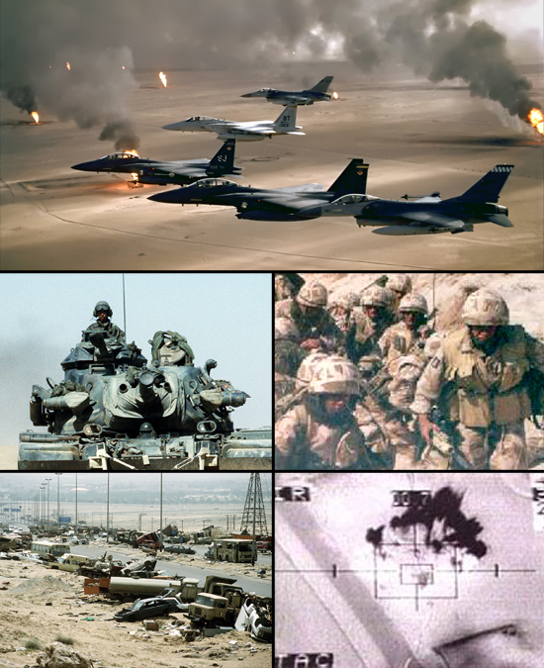
The Gulf War, 1991

Slide 53
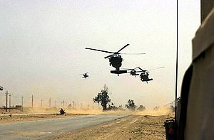
Iraq, March 2003

Slide 54
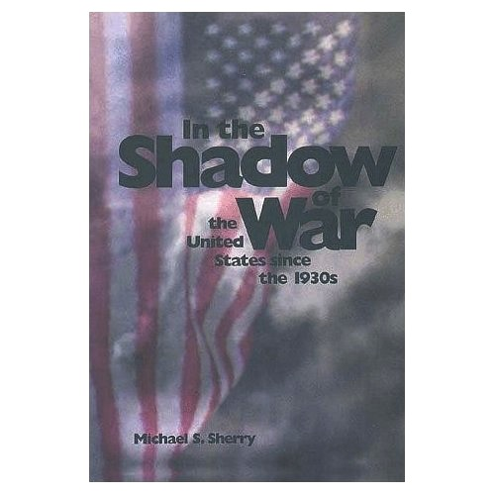

Slide 55
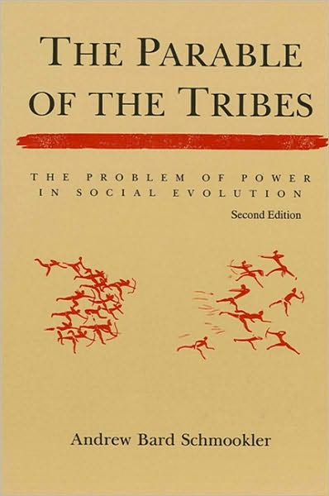

Slide 56
Was this war necessary (did it have just causes)?
Were the means used in this war just?
What were the costs of this war?
What were the long-term consequences of this war?
5. Is there an alternative story for postwar America?

Slide 57
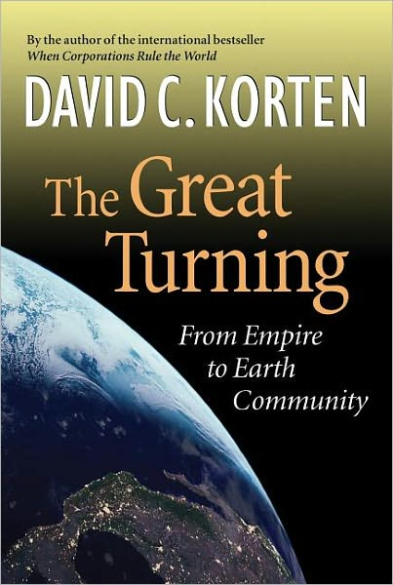

Slide 58
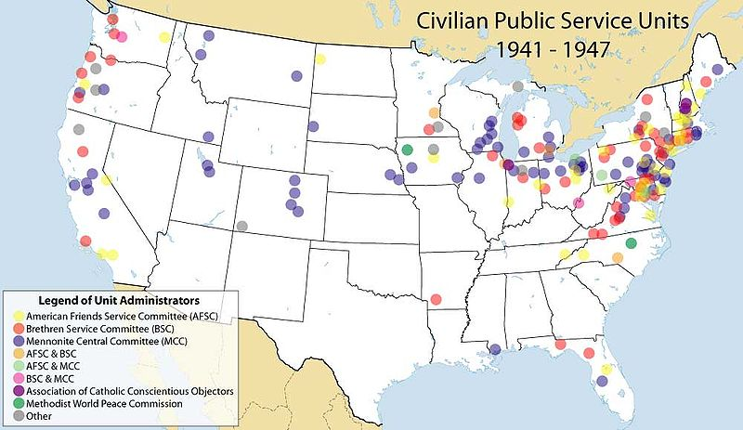

Slide 59
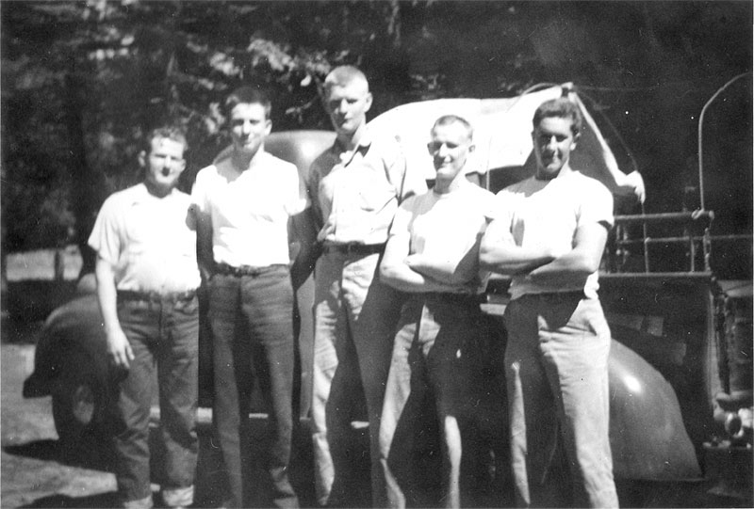
Conscientious Objectors as Fire Fighters

Slide 60
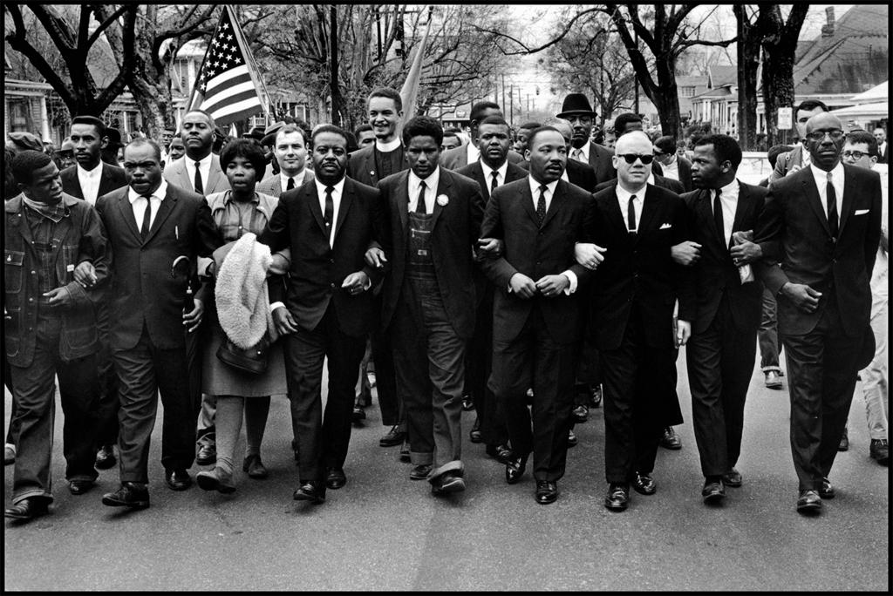
Marching for justice, 1965

Slide 61
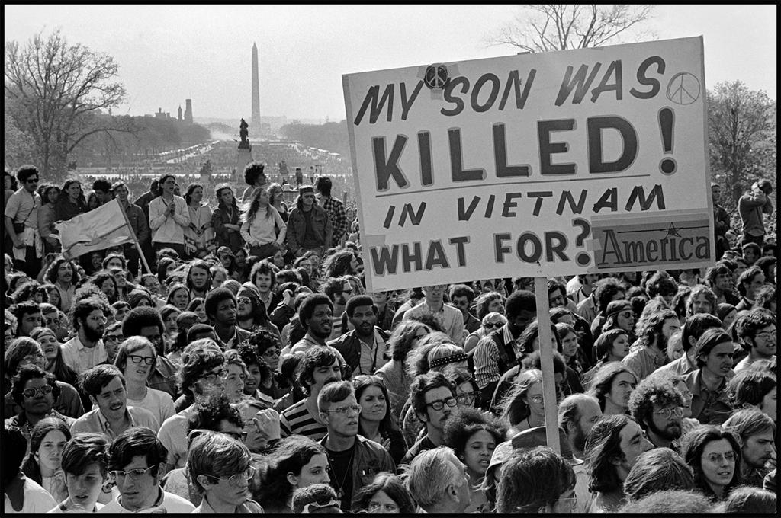
United States—1968

Slide 62


Slide 63
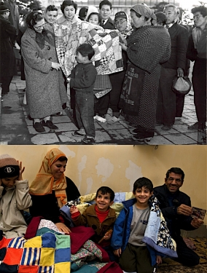
Mennonite Central Committee: Japan 1947 and Iraq 2007

Slide 64
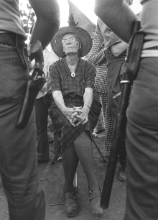
Dorothy Day, founder of the Catholic Worker, facing arrest in support of United Farm Workers

Slide 65
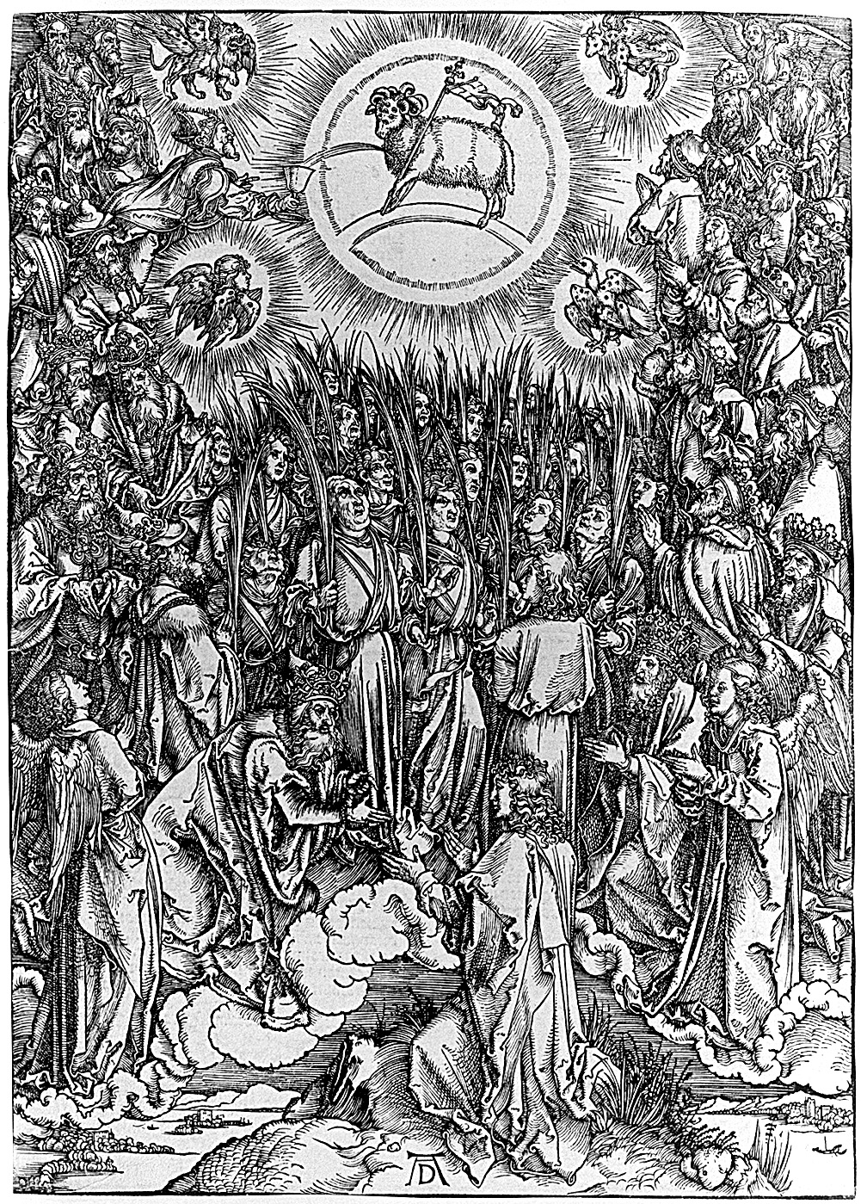
Albrecht Dürer, “The Adoration of the Lamb”

Slide 66
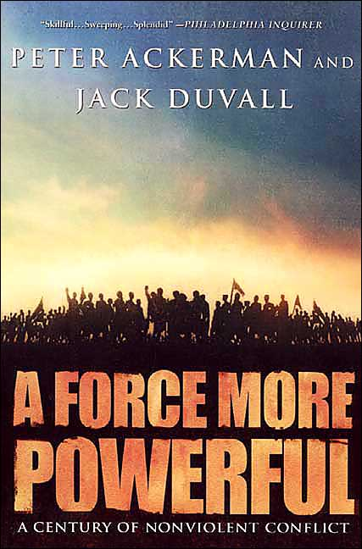

Slide 67
Recommended Reading
Nicholson Baker. Human Smoke: The Beginnings of World War II, the End of Civilization. Simon and Schuster, 2007.
Michael Bess. Choices Under Fire: Moral Dimensions of World War II. Knopf, 2006.
Patrick Buchanan. Churchill, Hitler and the Unnecessary War. Crown, 2008.
James Carroll. House of War: The Pentagon and the Disastrous Rise of American Power. Houghton Mifflin, 2006.
Norman Davies. No Simple Victory: World War II in Europe, 1939-1945. Penguin, 2006.
John Dower. War Without Mercy: Race and Power in the Pacific War. Pantheon, 1986.
A. C. Grayling. Among the Dead Cities: The History and Moral Legacy of the WWII Bombing of Civilians in Germany and Japan. Walker, 2006.
William Hitchcock. The Bitter Road to Freedom: A New History of the Liberation of Europe. Free Press, 2008.
Kenneth Rose. Myth and the Greatest Generation: A Social History of Americans in World War II. Routledge, 2008.
Jonathan Schell. The Unconquerable World: Power, Nonviolence, and the Will of the People. Metropolitan, 2003.
Tim Weiner. Legacy of Ashes: The History of the CIA. Anchor, 2008.
Peacetheology.net/world-war-ii/
Check here for drafts of the chapters from Ted Grimsrud, The Long Shadow: World War II’s Moral Legacy, and other updates on this project.

